Slide 1

Remote Meeting Scheduling with Connectify
Comprehensive analysis of Connectify, a scheduling sol ution for
remote teams.

Slide 2


Understanding the Scheduling Challenge for Remote Teams
Exploring Factors Affecting Meeting Coordination in Remote Work
Time Zone Differences
Remote employees in various global locations struggle with over lapping availability, complicating meeting scheduling.
Notification
Notify the Participants about the meeting.

Slide 3
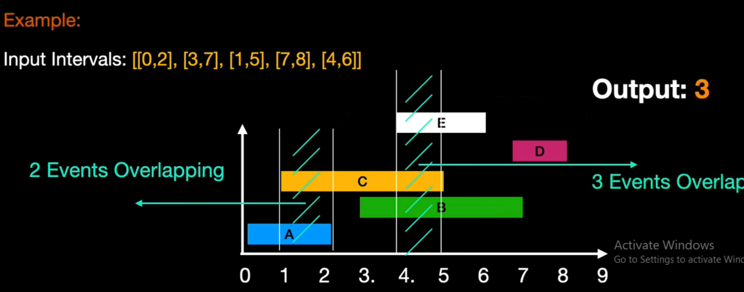
Introduction to Connectify. A Solution for
Scheduling
Optimizing Remote Meeting Scheduling with Connectify
Overlapping Time Detection
Identifies available time slots for all participants, minimizing conflicts

Slide 4

How Connectify Works The Scheduling Algorithm
Optimizing Remote Meeting Scheduling with Connectify
Time Slot Analysis
Analyzes overlapping intervals to find optimal meeting times.
Data Collection
Gathers participant availability from integrated calendars.
Recommendation Engine
Suggests the best time slots to the meeting host.
’ ‹’-n 1 .: g
preseutotionsœ

Slide 5
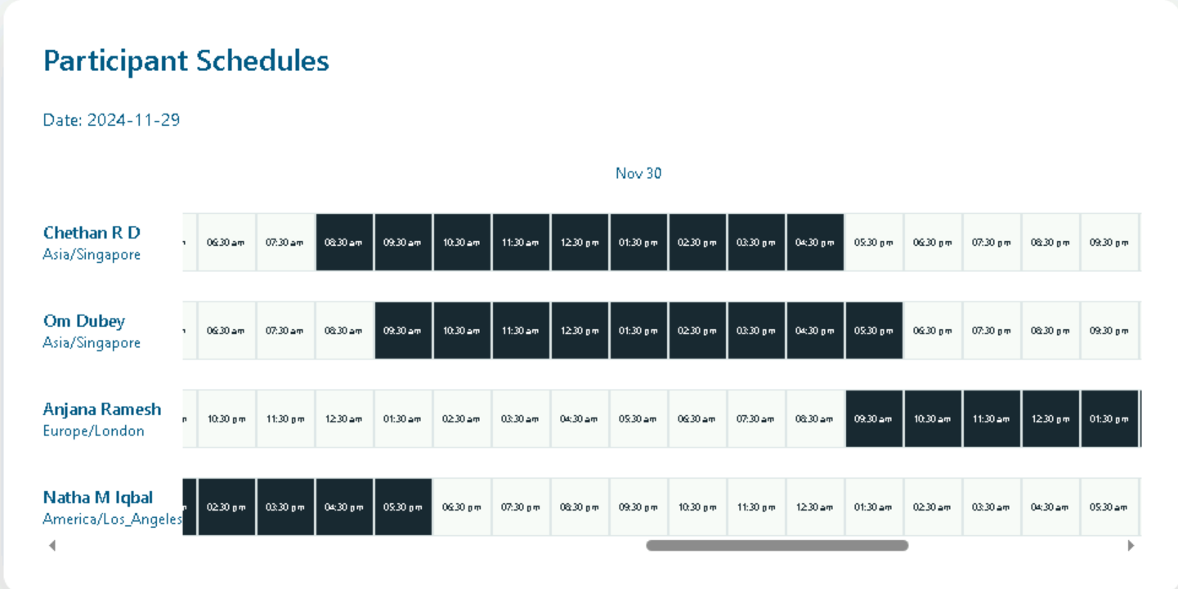
How Connectify Works : The Scheduling Algorithm Core Component of the Application

Slide 6
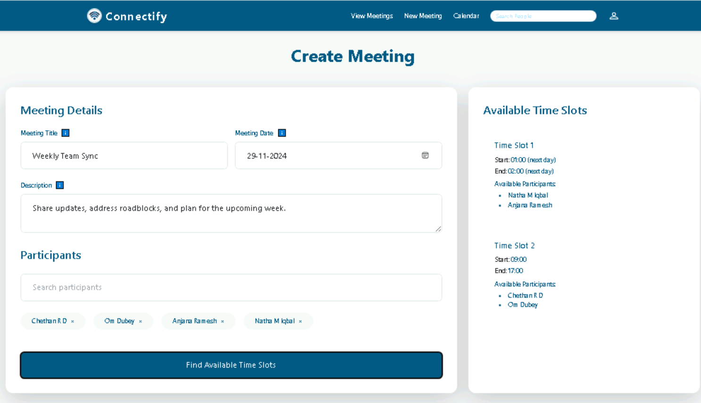

Slide 7
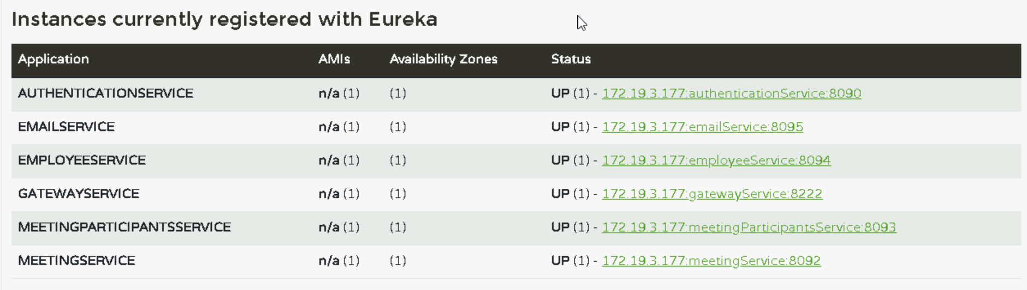

Slide 8



Tecn StacK Overview Building Connectify
Leveraging a Robust Tech Stack for Scalability and Performance
Frontend | Backend | Database
Utilizes React.js for creating responsive and | E mplays Spring Boot far raoust API | Incor palates MongoDB far flexiole data
dynamic user interfaces that enhance user experience. | development, enaoling effective oackend services. | storage and efficient retr ieval processes.
’ ‹’-n 1 .: g
preseutotionsœ

Slide 9

Transform Your Meeting
Experience
Join us in optimizing your remote meeting scheduling with Connectify.

